Slide 1
UQAT presents five medals of honour to educational leaders from the communities of Ivujivik, Puvirnituq and UQAT
Unité de recherche, de formation et de développement en éducation
en milieu inuit et amérindien (URFDEMIA)
November 16th, 2018
Photos credit: Paul Brindamour | UQAT

Slide 2
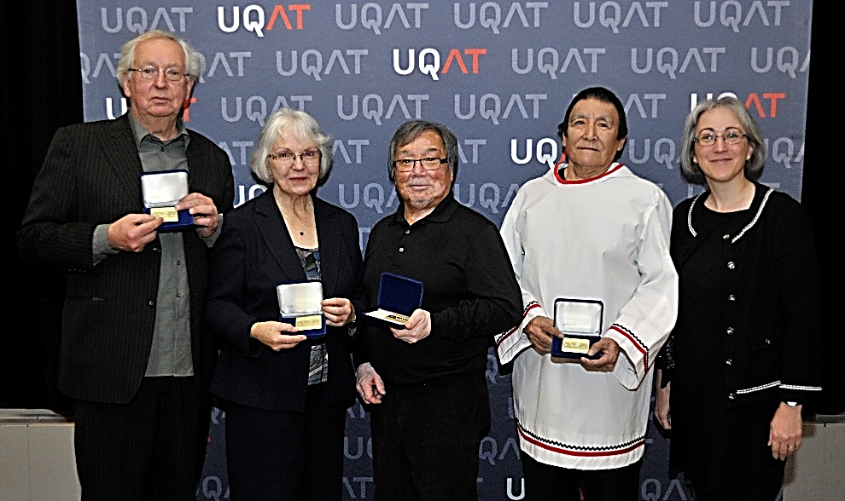
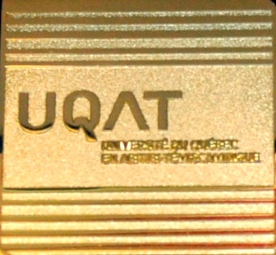
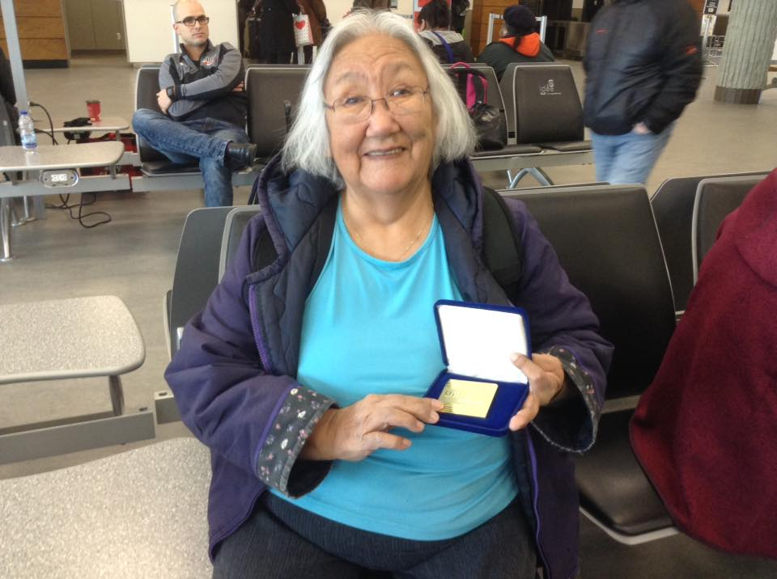
Recipients
Gérald McKenzie
Gisèle Maheux
Aipilie Kenuajuak
Jani Mangiuk
Tiili Alasuak (2nd picture, photographer Sarah Angiyou)
Manon Champagne (vice-president, teaching, research and creation - UQAT)

Slide 3
UQAT honoured Tiili Alasuak (Puvirnituq), Aipilie Kenuajuak (Puvirnituq), Jani Mangiuk (Ivujivik), Gérald McKenzie (Montreal), and Gisèle Maheux (UQAT).
These people were key players in developing one of the first partnerships between UQAT and Indigenous peoples, a partnership established in 1984, soon after UQAT’s creation in 1983. Together, through their openness, willpower, vision, and actions, these players not only empowered communities to take control of education but also helped to define and implement a unique model of partnership that puts community needs at the centre of processes for training, development, and research.
An unprecedented approach with big benefits
From the outset a co-management committee, made up of Inuit educational leaders and university trainers from UQAT, was set up for the projects. With regard to Inuit teacher training, the partnership has helped to develop and implement three certificate programs for those Inuit teachers who are already teaching. These programs, available since 1987, are the certificate in preschool and primary school teaching in a northern environment, the certificate in preschool and primary school teaching in a northern environment II, and the certificate in development of teaching practice in a northern environment. All three programs are funded by Kativik Ilisarniliriniq.

Slide 4
Tiili Alasuak
Tiili Alasuak began her work on the education committee of Puvirnituq back in the 1970s. She was a teacher at Iguarsivik School and then a pedagogical counselor from 1995 to 2008. She continued working as a pedagogical counselor at the new Ikaarvik School from 2008 to 2013. She sat on the co-management committee of the Comprehensive Educational Project until she retired in 2013. She was a key member. As a language specialist, she contributed to work on curricula in Inuktitut and on development of education vocabulary in Inuktitut. Tiili Alasuak also took part in Inuit teacher training by serving as a co-teacher with UQAT professors. In addition to this impressive record of involvement, she graduated from both of our university’s certificate programs for Preschool and Primary School Teaching in a Northern Environment. Tiili Alasuak has played a crucial role in giving direction to Inuit schools since the 1970s.

Slide 5
Aipilie Kenuajuak
Aipilie Kenuajuak was the principal of Iguarsivik School and then Ikaarvik School from 1983 to his retirement in 2014. Meanwhile he was an active member of the co-management committee for the Comprehensive Educational Project. Together with a Qallunaat math teacher, he developed and provided Inuit teachers with training activities in mathematics as a co-teacher, thereby helping to create a preliminary math curriculum for the students. Despite the time and energy needed for these commitments, he completed the certificate program for Preschool and Primary School Teaching in a Northern Environment and received his diploma. Aipilie Kenuajuak played a key role in developing education in his community by becoming one of the few Inuit school principals in Nunavik. He was a model for all of the teachers and students. He was also outstanding in his willingness to work with and be open to the other culture. He worked with Qallunaat to create strong working groups for teacher training and for administration of his school. Both of these achievements were widely admired throughout Nunavik.

Slide 6
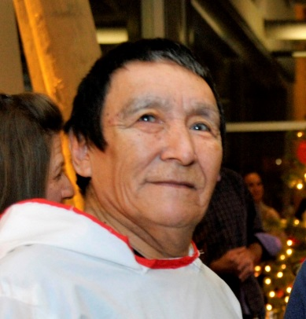
Jani Mangiuk
Jani Mangiuk was a member of the Inuit movement Tungavingat Nunamini, which opposed the James Bay and Northern Quebec Agreement in the little community of Ivujivik. He was also active on the Ivujivik Education Committee and sat on the co-management committee for the Comprehensive Educational Project from 1984 to 1990. Jani Mangiuk played a major political role in establishing the Puvirnituq and Ivujivik education committees. He continued his work of defending the development of Inuit education as a commissioner with the Kativik School Board.

Slide 7
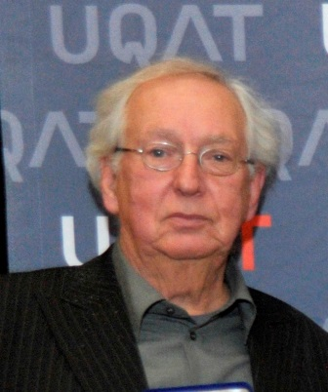
Gérald Mckenzie
Gérald McKenzie was the principal of Puvirnituq School, Ivujivik School, and Salluit School from 1975 to 1978. Then, from 1978 to 1980, he was an advisor for the parents’ committees during the negotiations for the opening of the schools. He was the principal of the provincially run school of Puvirnituq and Ivujivik from 1980 to 1982, and then co-principal of IPUIT, which administered the dissident schools. He took part in the Puvirnituq-Ivujivik–UQAT group for co-management of training programs from 1984 to 1994. Gérald McKenzie was the resource person who provided the link between the education committee members and UQAT when they were looking for a university partner. His knowledge of the history of the development of Nunavik education and his wide-ranging and still ongoing work not only with its leaders but also with young Inuit have made him a valuable intermediary between academia and Inuit culture.

Slide 8
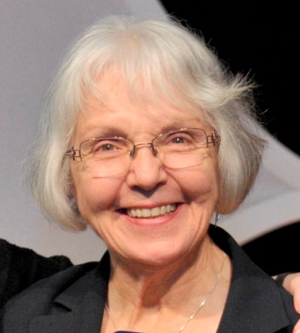
Gisèle Maheux
As a UQAT professor who was involved in development activities for small communities, Gisèle Maheux took part in meetings that followed the initial contact by our university’s representatives with the education committees in Puvirnituq and Ivujivik. She assumed the leadership of the co-management committee and responsibilities for training programs from 1984 to 2005, in addition to acting as an academic resource person for the courses. She helped to organize and develop different projects of the co-management committee with respect to training and curricula. Gisèle Maheux has also contributed for many years to a training development project with Temuco Catholic University in Chile. Through these training, development, and research activities with different Indigenous communities in the Americas (Inuit, Algonquin, Cree, Mapuche), she helped to train Indigenous teachers and develop education continuously throughout her career. Now a retired UQAT professor, she is still playing a major role as a mentor for new professors at our university, for students, and for technical and professional support staff who are today carrying out the mission of URFDEMIA.

Slide 9
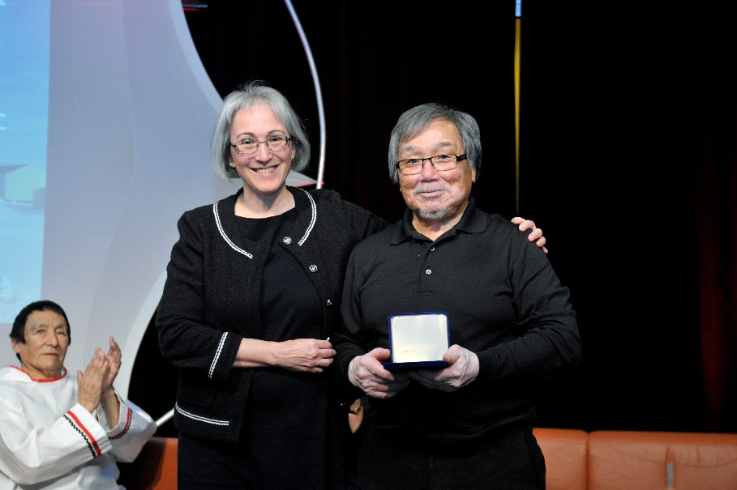
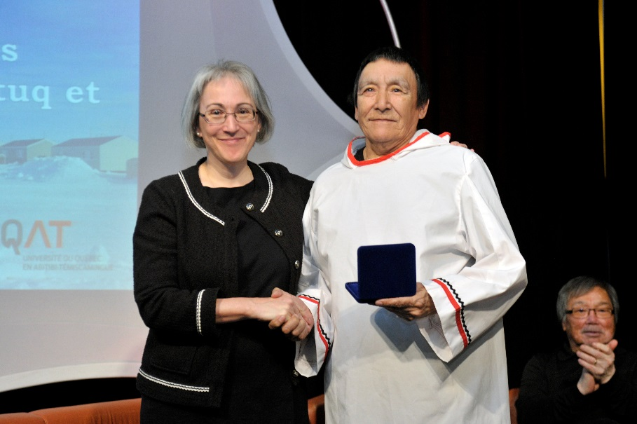
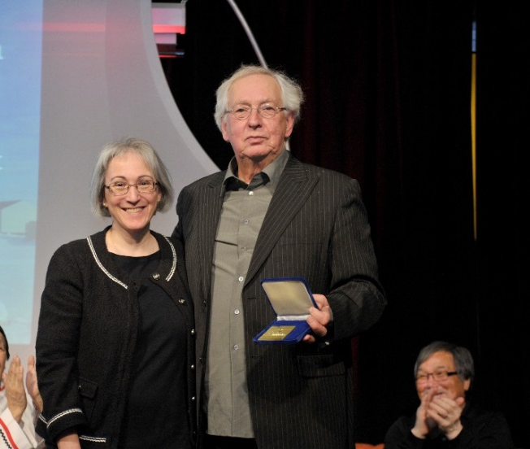
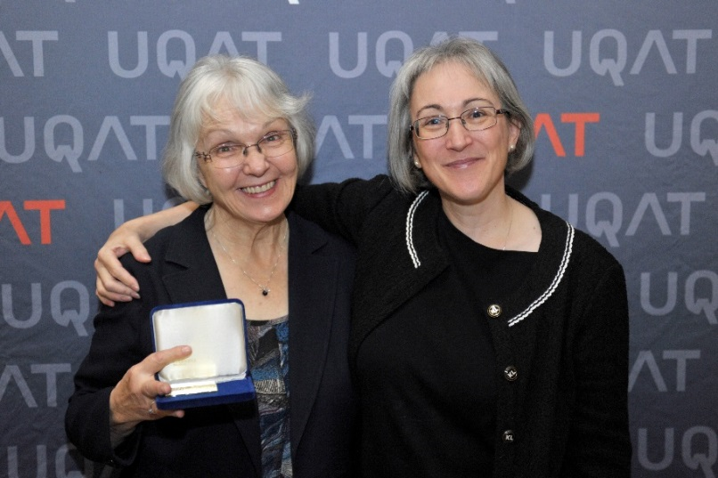
Presentation of the medals
Manon Champagne, Aipilie Kenuajuak
Manon Champagne, Jani Mangiuk
Manon Champagne, Gérald McKenzie
Gisèle Maheux, Manon Champagne

Slide 10
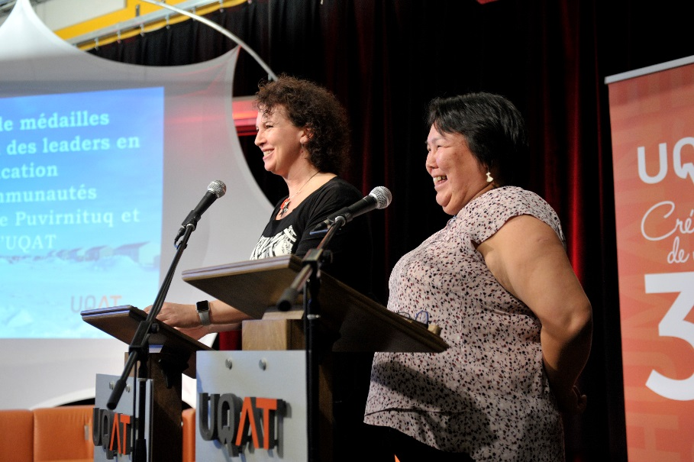
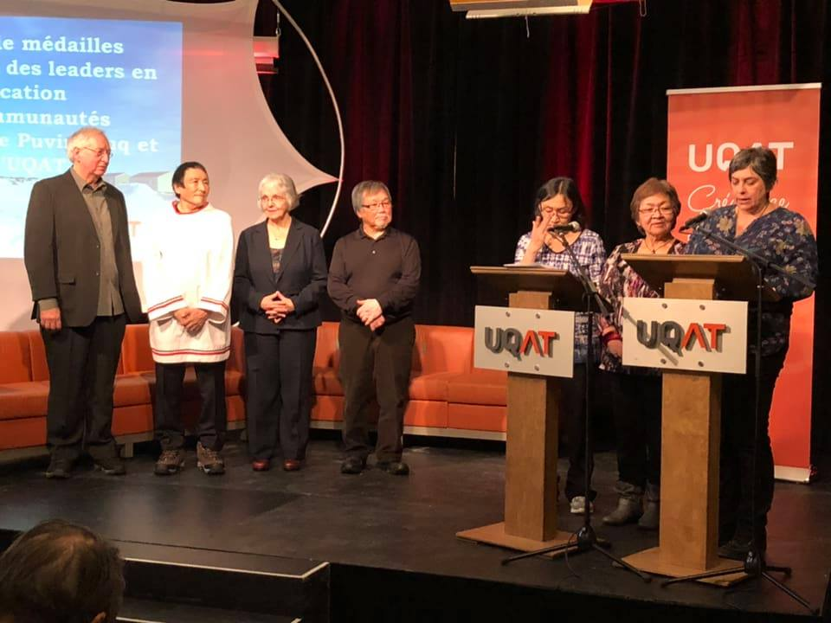
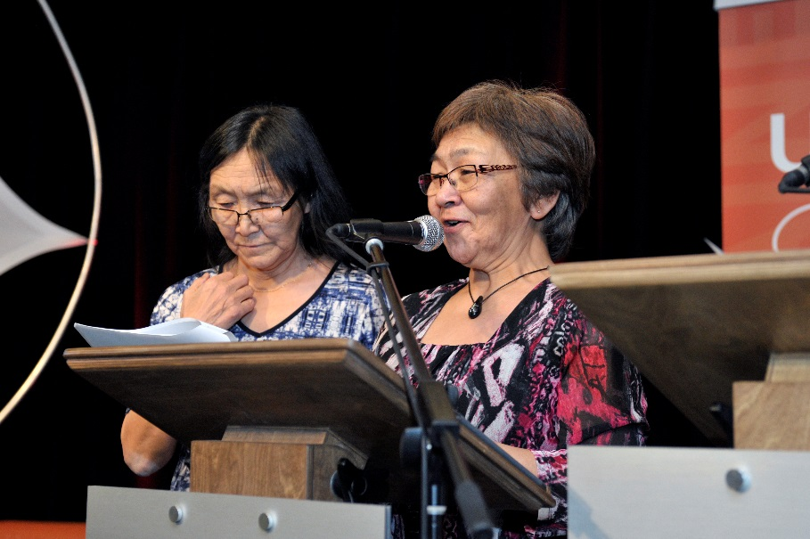
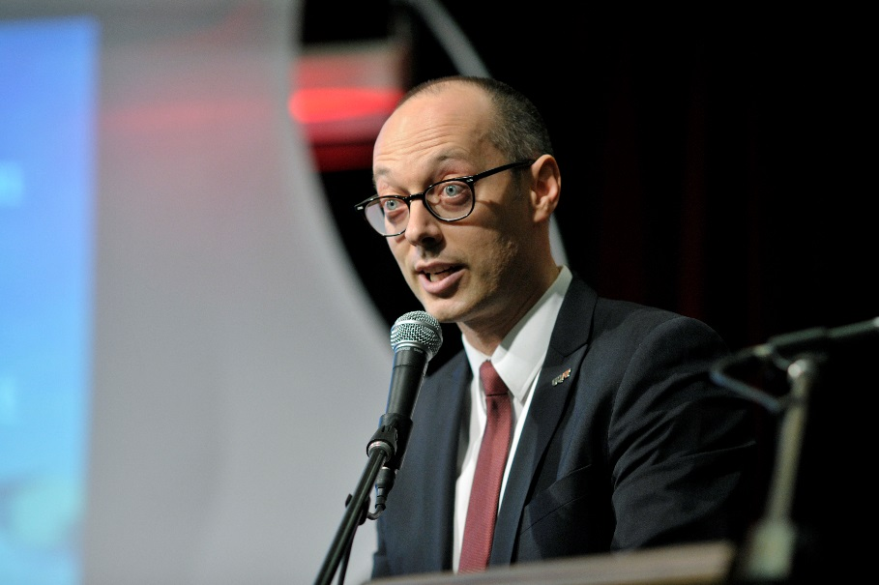
Ceremony speeches
Glorya Pellerin (UQAT co-management group member), Sarah Angiyou (Puvirnituq co-management group member)
Recipients, Siaja Mangiuk, Elisapi Uitangak, Lily Bacon (UQAT co-management group member)
Siaja Mangiuk (Ivujivik co-management group member), Elisapi Uitangak (Puvirnituq co-management group member)
Vincent Rousson (campus Val-d’Or director – UQAT)

Slide 11
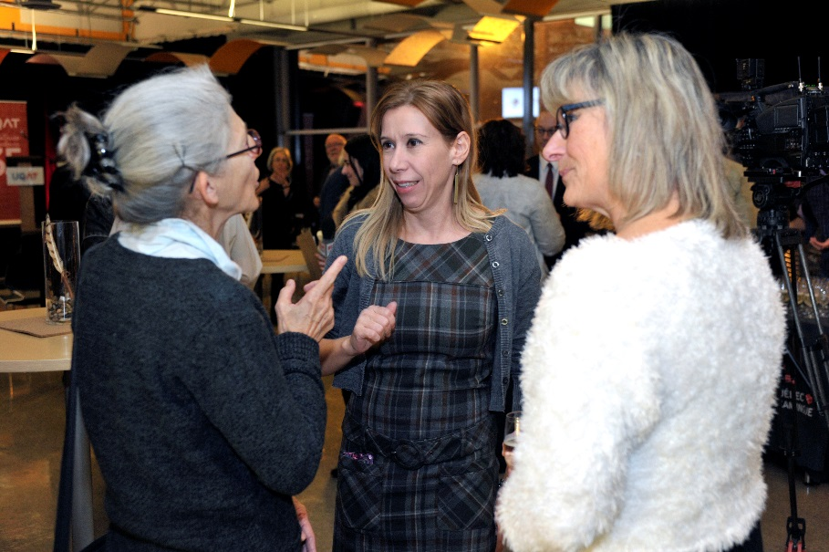
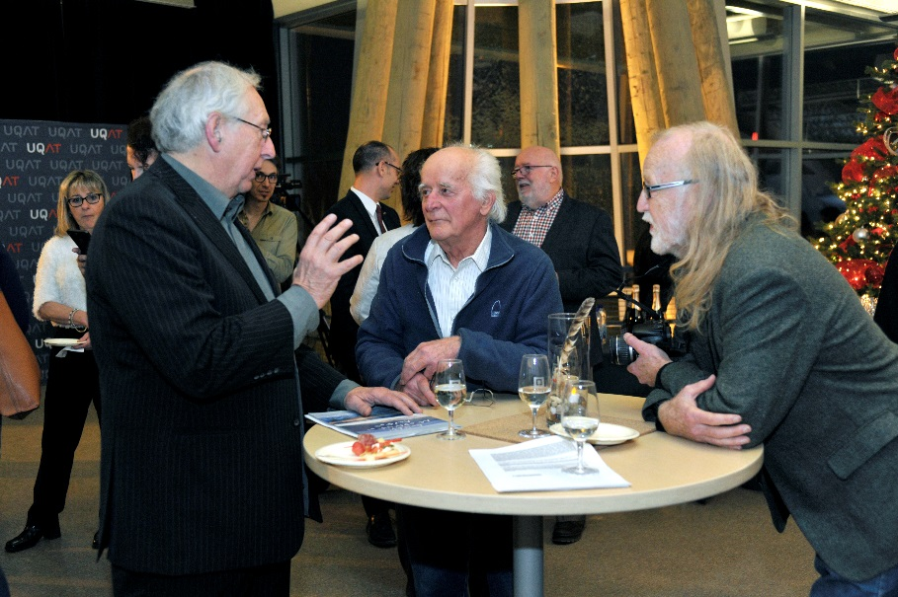
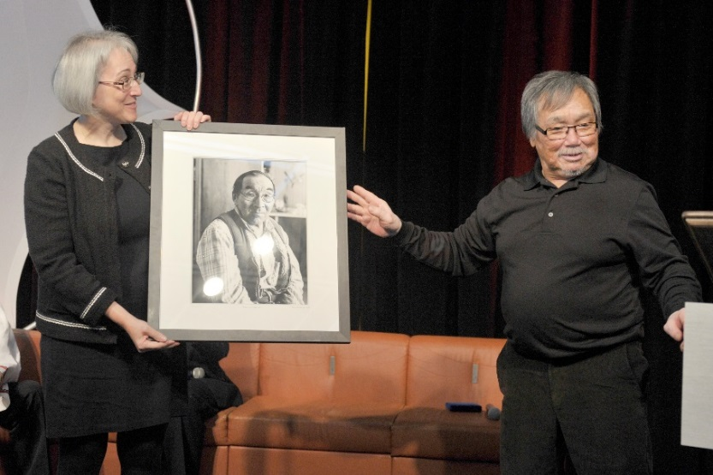
Attendees
Three research agents of Inuit teacher training:
Diane Simard (1987-2006), Véronique Paul (2008- today) et Maryse Delisle (2007-2009)
Gérald McKenzie (recipient), Charles Bergeron (retired profressor from education department-UQAT), Claude Vallières (former assistant principal Iguarsivik School Puvirnituq)
Painting gift of Taamusi Qumaq to UQAT from Tukisivallirutitsanut Parnaitiit (Gérald McKenzie, photographer)

Slide 12
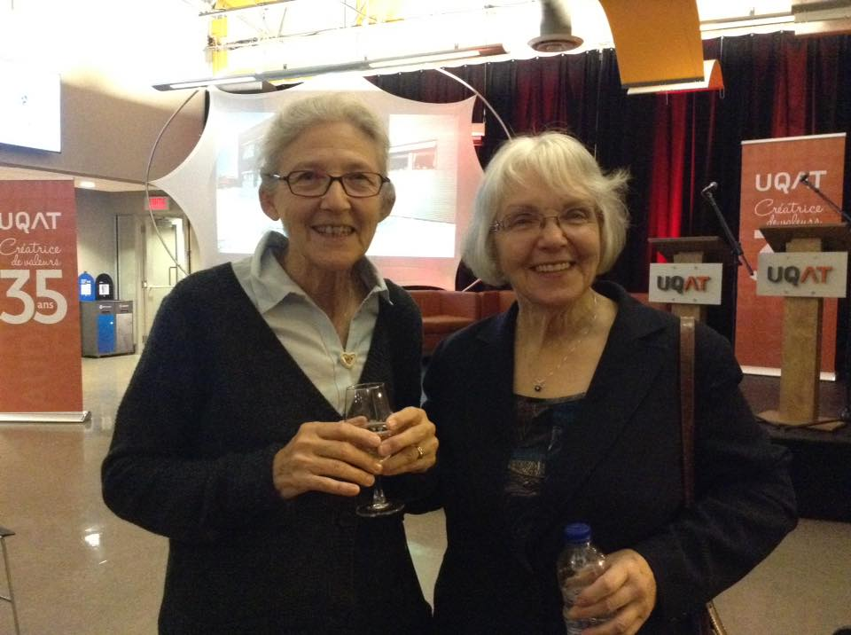
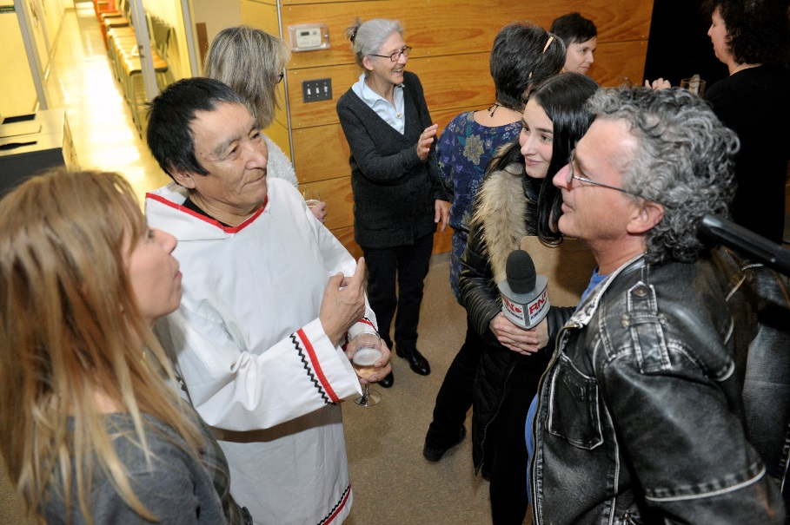
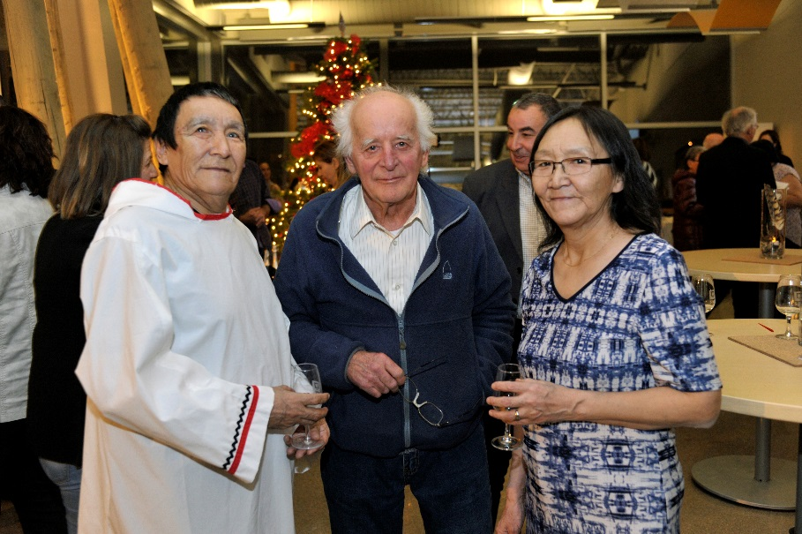
Diane Simard, Gisèle Maheux
Véronique Paul (co-management group member UQAT), Jani Mangiuk, interviewers
Jani Mangiuk, Charles Bergeron, Siaja Mangiuk

Slide 13
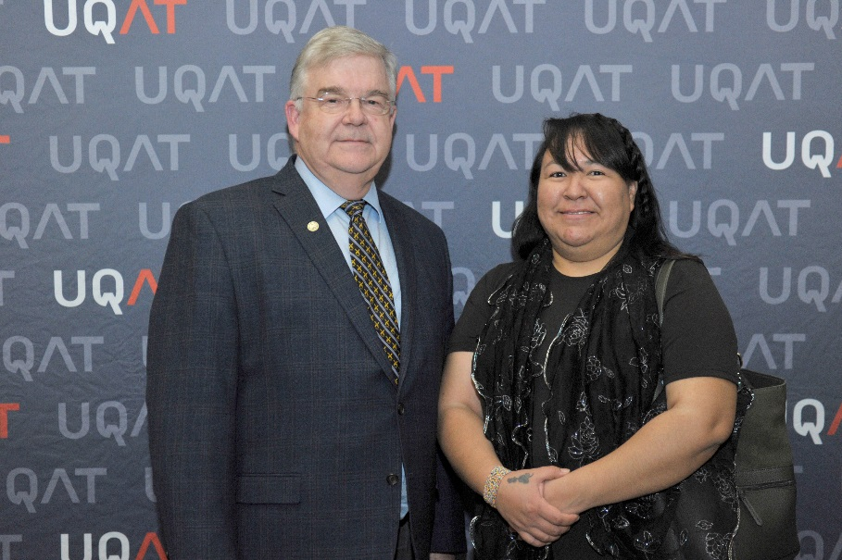
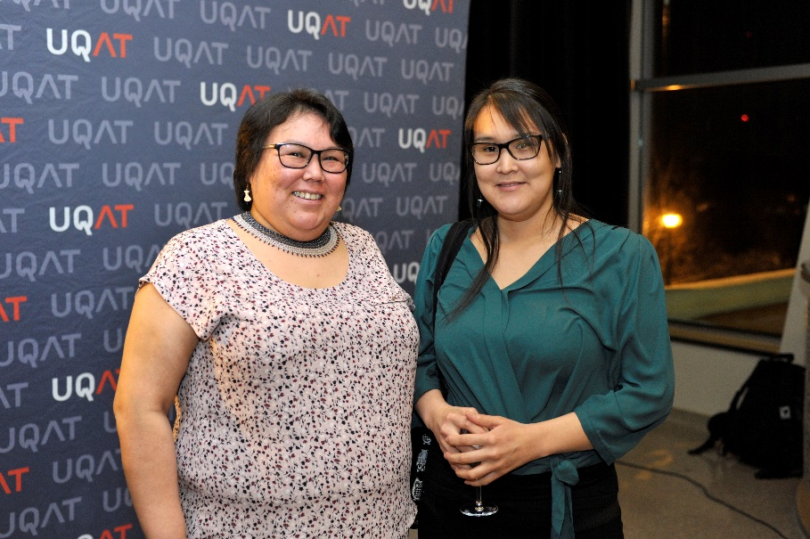
Pierre Corbeil Lucy Qalingo
Mayor of Val-d’Or Mayor of Puvirnituq
Sarah Angiyou (Puvirnituq co-management group member)
Quara Sarah Amamatuak (education committee Puvirnituq)
13

Slide 14
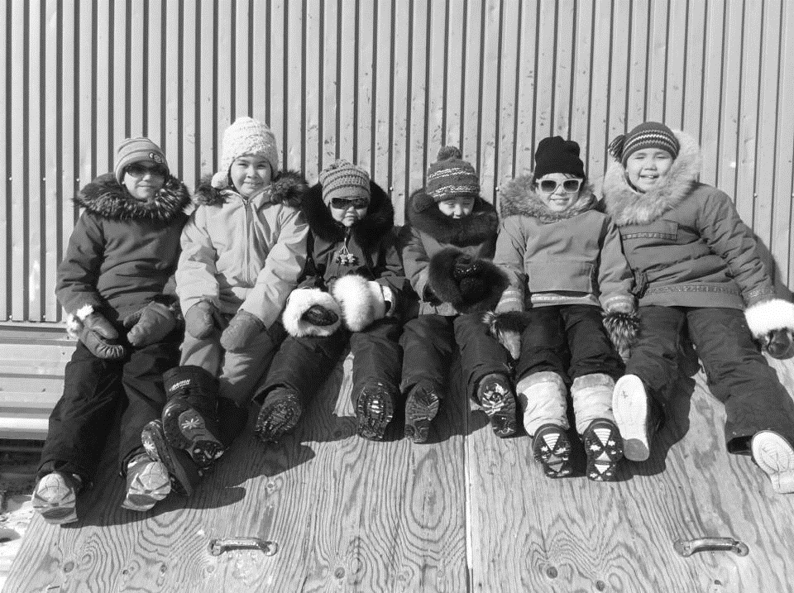
Thank you! Nakurmiik!
We would like to thank you our partners who made this event possible!

